Slide 1
Money Matters: A Personal Finance Management App
Presented by R. Karthik

Slide 2
Description
Money Matters is an intuitive and comprehensive personal finance management app designed to help users track, manage, and optimize their financial resources. The app aims to empower individuals to make informed financial decisions, achieve their monetary goals, and secure a stable financial future.

Slide 3
Java program
import java.util.ArrayList;
import java.util.Scanner;
// Class to represent a transaction
class Transaction {
private String type;
private double amount;
private String description;
public Transaction(String type, double amount, String description) {
this.type = type;
this.amount = amount;
this.description = description;
}

Slide 4
public String getType() {
return type;
}
public double getAmount() {
return amount;
}
public String getDescription() {
return description;
}
}
// Class to represent a budget category
class BudgetCategory {

Slide 5
private String name;
private double budget;
private ArrayList<Transaction> transactions;
public BudgetCategory(String name, double budget) {
this.name = name;
this.budget = budget;
this.transactions = new ArrayList<>();
}
public String getName() {
return name;
}
public double getBudget() {
return budget;
}

Slide 6
public ArrayList<Transaction> getTransactions() {
return transactions;
}
public void addTransaction(Transaction transaction) {
transactions.add(transaction);
}
}
public class MoneyMatters {
private ArrayList<BudgetCategory> budgetCategories;
private Scanner scanner;
public MoneyMatters() {
this.budgetCategories = new ArrayList<>();

Slide 7
this.scanner = new Scanner(System.in);
}
public void run() {
while (true) {
System.out.println("1. Add budget category");
System.out.println("2. Add transaction");
System.out.println("3. View budget categories");
System.out.println("4. Exit");
System.out.print("Choose an option: ");
int option = scanner.nextInt();
scanner.nextLine(); // Consume newline left-over
switch (option) {
case 1:
addBudgetCategory();
break;
case 2:

Slide 8
addTransaction();
break;
case 3:
viewBudgetCategories();
break;
case 4:
System.out.println("Exiting...");
return;
default:
System.out.println("Invalid option. Please choose again.");
}
}
}
private void addBudgetCategory() {
System.out.print("Enter budget category name: ");
String name = scanner.nextLine();

Slide 9
System.out.print("Enter budget amount: ");
double budget = scanner.nextDouble();
scanner.nextLine(); // Consume newline left-over
BudgetCategory budgetCategory = new BudgetCategory(name, budget);
budgetCategories.add(budgetCategory);
System.out.println("Budget category added successfully!");
}
private void addTransaction() {
System.out.print("Enter transaction type (income/expense): ");
String type = scanner.nextLine();
System.out.print("Enter transaction amount: ");
double amount = scanner.nextDouble();
scanner.nextLine(); // Consume newline left-over
System.out.print("Enter transaction description: ");
String description = scanner.nextLine();

Slide 10
Transaction transaction = new Transaction(type, amount, description);
if (budgetCategories.isEmpty()) {
System.out.println("No budget categories available. Please add a budget category first.");
return;
}
System.out.println("Available budget categories:");
for (int i = 0; i < budgetCategories.size(); i++) {
System.out.println((i + 1) + ". " + budgetCategories.get(i).getName());
}
System.out.print("Choose a budget category: ");
int categoryIndex = scanner.nextInt();
scanner.nextLine(); // Consume newline left-over

Slide 11
if (categoryIndex < 1 || categoryIndex > budgetCategories.size()) {
System.out.println("Invalid budget category choice.");
return;
}
BudgetCategory budgetCategory = budgetCategories.get(categoryIndex - 1);
budgetCategory.addTransaction(transaction);
System.out.println("Transaction added successfully!");
}
private void viewBudgetCategories() {
if (budgetCategories.isEmpty()) {
System.out.println("No budget categories available.");
return;
}

Slide 12
System.out.println("Budget Categories:");
for (BudgetCategory budgetCategory : budgetCategories) {
System.out.println("Name: " + budgetCategory.getName());
System.out.println("Budget: " + budgetCategory.getBudget()) ;
System.out.println("Transactions:");
for (Transaction transaction : budgetCategory.getTransactions()) {
System.out.println("Type: " + transaction.getType());
System.out.println("Amount: " + transaction.getAmount());
System.out.println("Description: " + transaction.getDescription());
}
System.out.println();
}
}
public static void main(String[] args) {
MoneyMatters moneyMatters = new MoneyMatters();
moneyMatters.run();
}
}

Slide 13

Output:

Slide 14
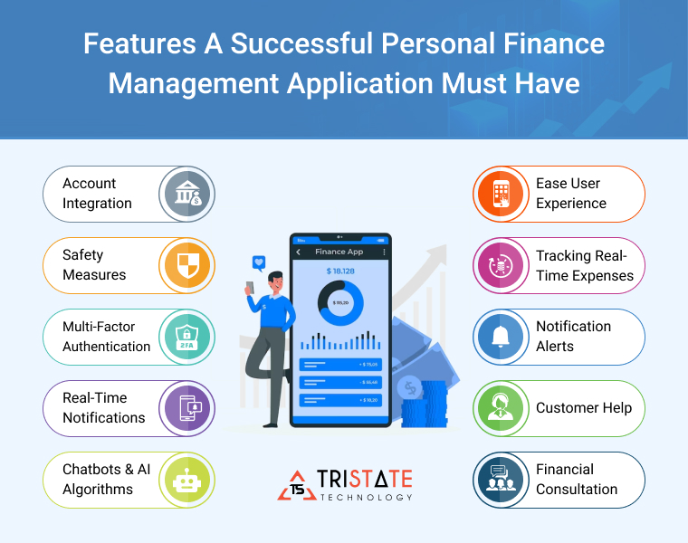

Slide 15
Conclusion
Money Matters is a comprehensive personal finance management app designed to simplify financial tracking, budgeting, and investment management. By providing actionable insights, automating financial tasks, and ensuring robust security, Money Matters empowers users to take control of their financial lives and achieve long-term stability.

